Slide 1

The Seven Royal Families
Creating the Beast System

Slide 2
Disclaimer
The information contained in this presentation is educational material only and is NOT intended to be considered investment advice. Mr. Mack is NOT a registered investment, legal, or tax advisor, or a broker/dealer of securities. All investment/financial opinions expressed by Mr. Mack are from personal research and experience and is intended as educational material only. Although best efforts are made to ensure that all the information contained herein is accurate and up to date, occasionally unintended errors and misprints may occur.

Slide 3
Fair Use Notice
The images and videos used in this presentation belong to their respective copyright holders.
These images and videos used in this presentation are being used for education, criticism, comment, teaching, and research purposes constituting a Fair Use Exemption under §107 of the United States Copyright Act of 1976.
“Fair Use” is defined by this law as a use permitted by copyright statute that might otherwise be considered infringement.
Any attempt by “copyright trolls” and other alleged legal counsel to infringe on this right shall be prosecutied to the fullest extent of the law both under §107 and the laws on the following page.

Slide 4
18 U.S. Code §241 - Conspiracy Against Rights
If two or more persons conspire to injure, oppress, threaten, or intimidate any person in any State, Territory, Commonwealth, Possession, or District in the free exercise or enjoyment of any right or privilege secured to him by the Constitution or laws of the United States, or because of his having so exercised the same; or
If two or more persons go in disguise on the highway, or on the premises of another, with intent to prevent or hinder his free exercise or enjoyment of any right or privilege so secured—
They shall be fined under this title or imprisoned not more than ten years, or both; and if death results from the acts committed in violation of this section or if such acts include kidnapping or an attempt to kidnap, aggravated sexual abuse or an attempt to commit aggravated sexual abuse, or an attempt to kill, they shall be fined under this title or imprisoned for any term of years or for life, or both, or may be sentenced to death.
(June 25, 1948, Ch. 645, 62 Stat. 696; Pub. L. 90–284, title I, § 103(a), Apr. 11, 1968, 82 Stat. 75; Pub. L. 100–690, title VII, §7018(a), (b)(1), Nov. 18, 1988, 102 Stat. 4396; Pub. L. 103–322, title VI, § 60006(a), title XXXII, §§ 320103(a), 320201(a), title XXXIII, § 330016(1)(L), Sept. 13, 1994, 108 Stat. 1970, 2109, 2113, 2147; Pub. L. 104–294, title VI, §§ 604(b)(14)(A), 607(a), Oct. 11, 1996, 110 Stat. 3507, 3511.)

Slide 5
Proverb for Today
The rich man is wise in his own conceit; but the poor that hath understanding searcheth him out. (Proverbs 28:11)

Slide 6
Creation of the Seven Royal Families
And the ten horns out of this kingdom are ten kings that shall arise: and another shall rise after them; and he shall be diverse from the first, and he shall subdue three kings. (Daniel 7:24)
So, he carried me away in the spirit into the wilderness: and I saw a woman sit upon a scarlet-colored beast, full of names of blasphemy, having seven heads and ten horns. (Revelation 17:3)
And the ten horns which thou sawest are ten kings, which have received no kingdom as yet; but receive power as kings one hour with the beast. These have one mind, and shall give their power and strength unto the beast. (Revelation 17:12-13)

Slide 7
Creation of the Seven Royal Families
When Daniel wrote this, none of these royal families existed. They didn’t exist when John Mark wrote Revelation either.
The other king that shall arise after them could be the House of Romanov (Russia). They have lots of scores to settle with the European Families and now, China is willing to align with them. China has plenty of scores to settle with the Royal Families as well.
The power of the Beast System comes only when the Seven Royal Families are able to unify into one family.

Slide 8

The Royal Families Plot to Subject the World
YouTube Link: https://www.youtube.com/watch?v=KGPlr1aoQ78
TikTok Link: https://www.tiktok.com/@tommack609/video/7235699886950288682?is_from_webapp=1&sender_device=pc&web_id=7230633203127158315

Slide 9

The Royal Families Plot to Subject the World
YouTube Link: https://www.youtube.com/watch?v=3f4qOEYoBRY
TikTok Link: https://www.tiktok.com/@tommack609/video/7235701312803851562?is_from_webapp=1&sender_device=pc&web_id=7230633203127158315

Slide 10

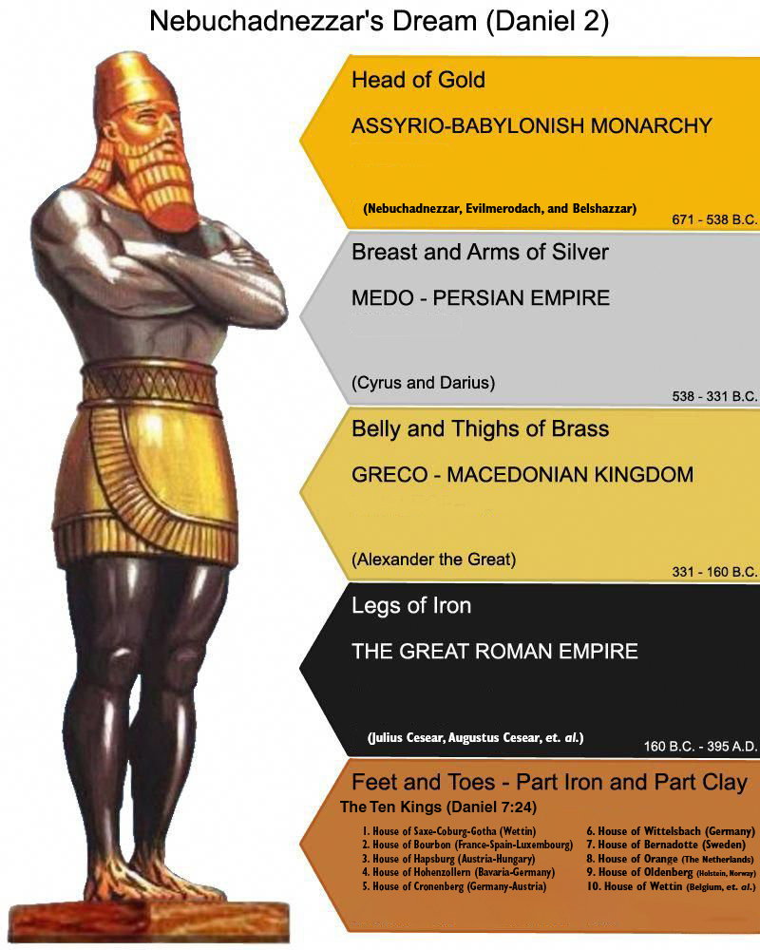
The First Reich – The Roman Empire
The Roman Empire is the successor empire envisioned by King Nebuchadnezzar when he dreamed of the statue in Daniel 2.
In this depiction, the Roman Empire is the Legs of Iron. Iron is the strongest of all the substances depicted in the statue.
It should be noted that the silver Persian Empire still exists today and is called Iran. However, it has not had any world ambitions since they were briefly conquered by Alexander the Great. However, their religion: Islam is still a factor in this.

Slide 11
The Second Reich – The Holy Roman Empire
The Second Reich was formed in A.D. 800 when Pope Leo III crowned the illiterate Charlemagne the Emperor of Rome.
He was the head of the Carolingian Family, descendants of the Merovingian Family.
They were in turn descendants of the line of Kings David and Solomon.
The Carolingian line would last until 899 when the last pure king died.

Slide 12
The Second Reich – The Holy Roman Empire
After the last true Carolingian king died, Europe spent six decades in a series of civil wars attempting to enthrone a new “Roman” emperor.
In A.D. 962, Pope John XII crowned Otto I king of the Roman Empire.
One of the more famous emperors was Frederick I Barbarossa who was crowned in 1155 by Pope Adrian IV. Hitler used his name as a code word for his invasion of Russia.
The Diet of Cologne in 1512 supposedly changed the name of the country to the “Holy Roman Empire of the Germanic Nation.”

Slide 13
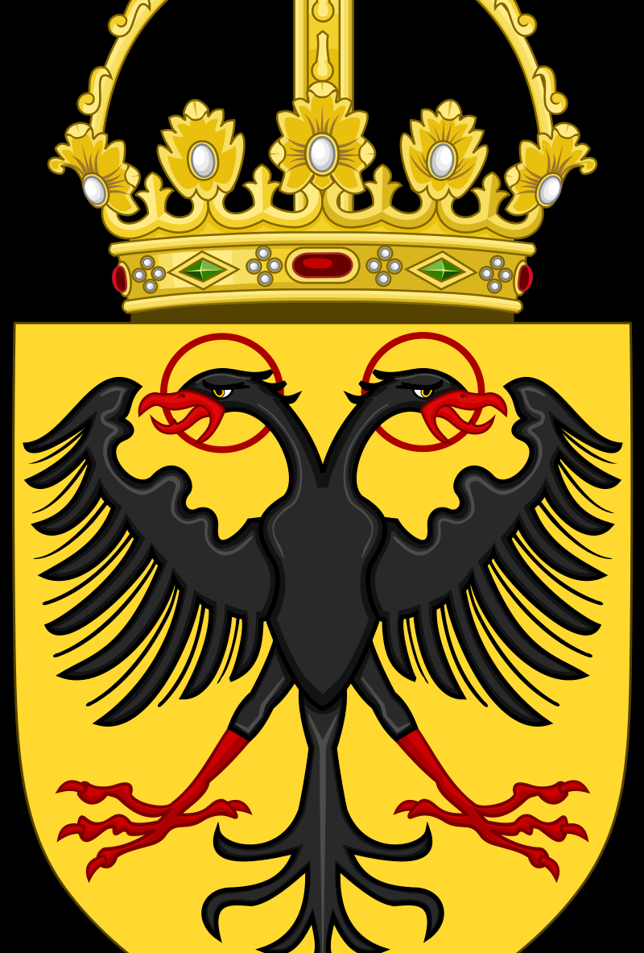
The Second Reich – The Holy Roman Empire
The development of the ten royal families occurred during this time, though none of them could rise to the title of “emperor” as Charlamagne I had done.
However, these families would contribute kings to all the nations of Europe and the British Isles.

Slide 14
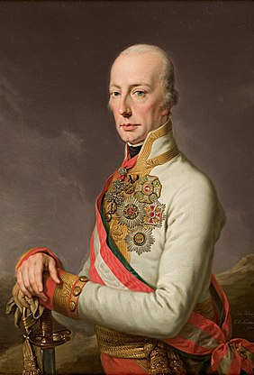
The Second Reich – The Holy Roman Empire
The French Victory at the Battle of Austerlitz on December 2, 1805, marked the end of the Holy Roman Empire.
Francis II, the last Holy Roman Emperor abdicated his throne on August 6, 1806.
He was one of the last ruling kings of the Austrian empire.

Slide 15
The Royal Families of Europe
The House of Wettin* (Belgium, Poland, et. al.)
The House of Saxe-Coburg-Gotha* (Windsor) (Cadet of the Wettin Line)
House of Bourbon/Bonaparte (France, Corsica, Florence)
House of Bernadotte * (Sweden)
House of Orange * (The Netherlands, England)
House of Oldenburg-Glücksburg ((Holstein (the nethermost province in Germany), Denmark, Norway)
The German Royal lines

Slide 16
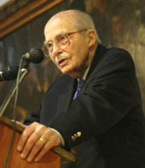
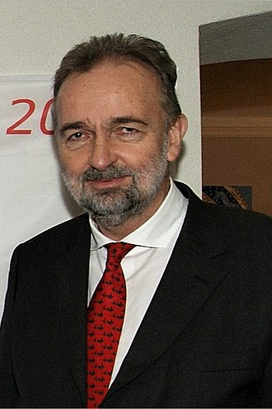
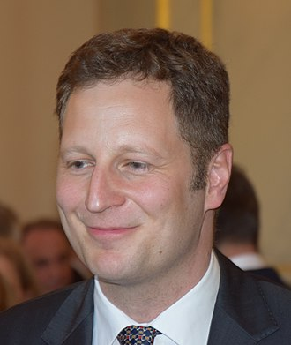
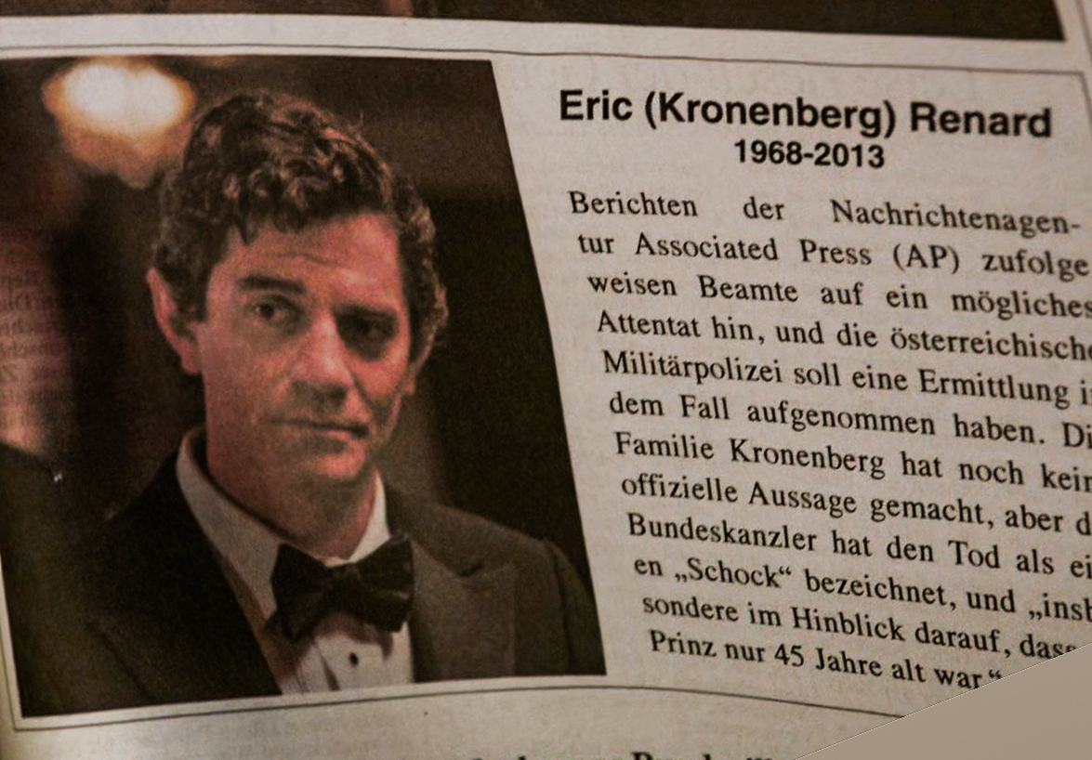
The Royal Families of the Germanic Peoples
House of Habsburg-Lorraine (Austria)
It should be noted that Otto von Habsburg addressed the first World Economic Forum meeting in 1971!
The Current Successor is Karl von Habsburg, a famous race car driver.
House of Hohenzollern (Bavaria-Prussia)
The Last German Kaisers (kings) were from this house. (Wilhelm I, Wilhelm II)
House of Cronenberg (Germany-Austria)
Two of the Princes and the king in the TV Show Grimm were Cronenbergs though the producers spelled it Kronenberg.
There was one prince in the show that was either from the House of Windsor or Hanover. (The Prince had a British Accent!)
House of Wittelsbach (Holy Roman Empire, Hungary, Greece, Bavaria, Spain)
These days, they have married into the House of Bourbon and rule Spain.
Their claims to rule any other part of Europe are dubious.
Prince Eric Portrayed by James Frain

Slide 17
The Other Royal Families of Germany
The House of Hanover (once ruled Great Britain, now extinct)
Queen Victoria I was from this house
House of Nassau (now extinct)
The capital of the Virgin Islands is named for this family.
House of Süpplinburger
Holy Roman Emperor Lothair III was from this family.
House of Württemberg
Frederick II ruled in the Rhine River Area

Slide 18
The Third Reich – Nazi Germany
Nazi Germany at its height, controlled all of Europe except for Sweden, Finland, Switzerland, and Spain.
Finland aligned with Nazi Germany early in World War II taking back the land they lost to Russia in years previous.
Sweden contributed considerable steel resources to Nazi Germany.
Spain remained aligned with Nazi Germany and contributed troops to the Axis cause.
Nazi Germany used Swiss banks to launder money to the rest of the world.
Hitler did consider invading Switzerland, but Martin Borman overruled the idea. He used the banks in his Nazi redoubt plans post-war.

Slide 19
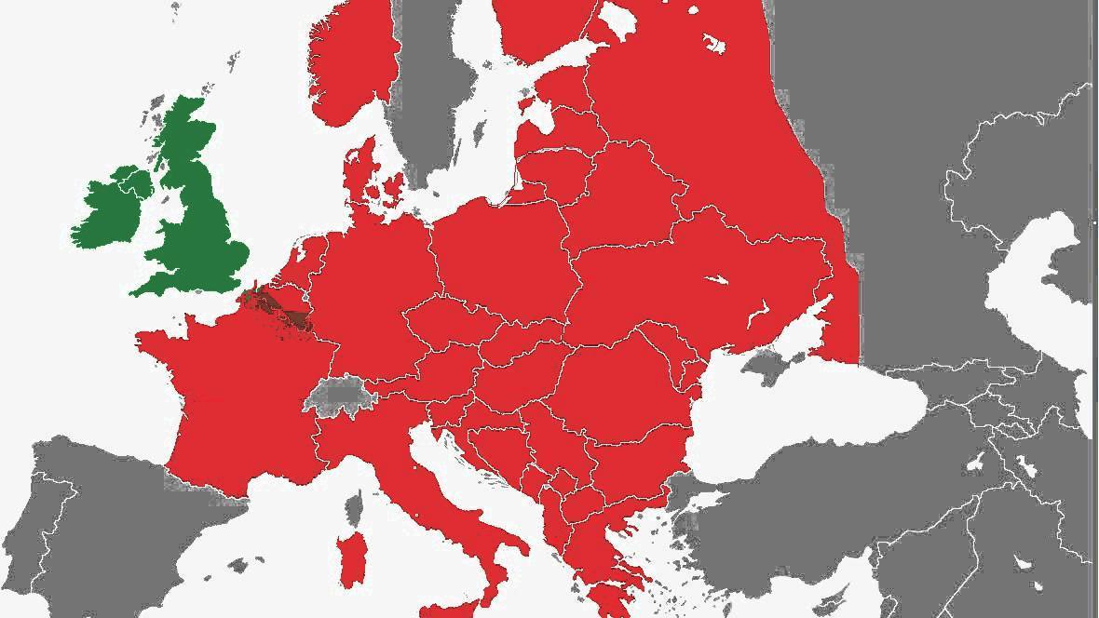

Slide 20
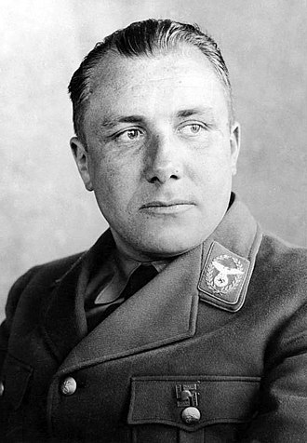
The Third Reich – Post War Adjustments
After the disaster of the Battle of Stalingrad in 1943, Martin Borman, became the effective Fuhrer of Nazi Germany. With the loss of the German Sixth Army, he realized that the War was lost.
Herr Borman knew that he had to make Herr Hitler look like he was the Fuhrer of Germany without letting him do any of the actual ruling.
Using the propaganda abilities of Dr. Joseph Goebbels and the Propaganda Ministry, he sold the idea of “Hitler in charge” with plenty of media showing him such.

Slide 21
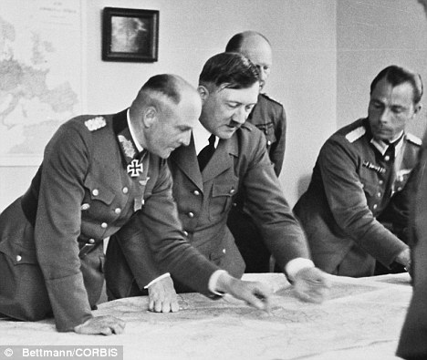
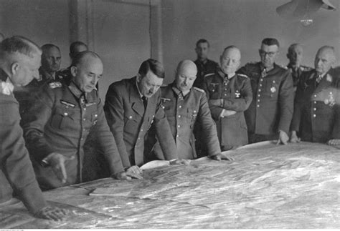
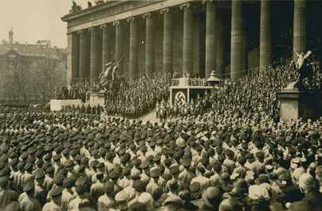
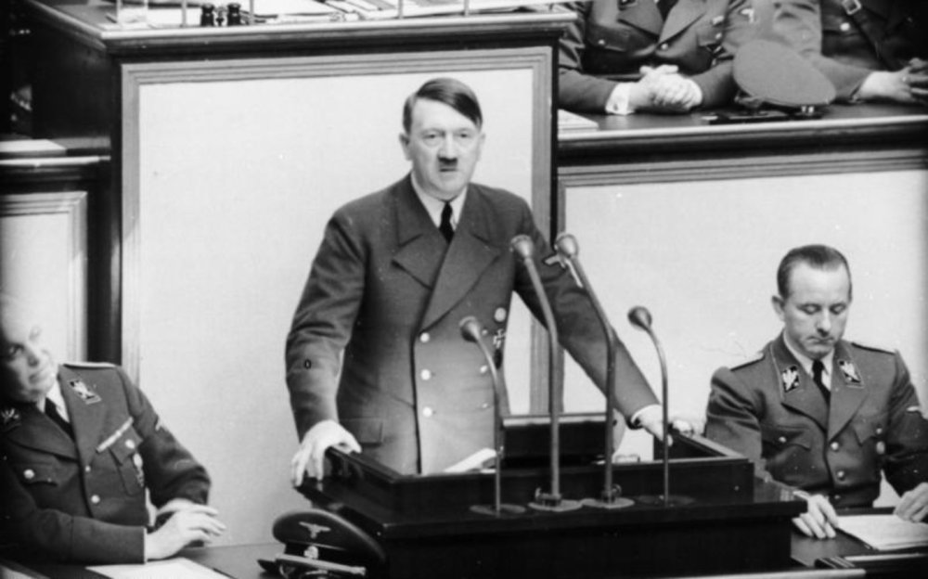
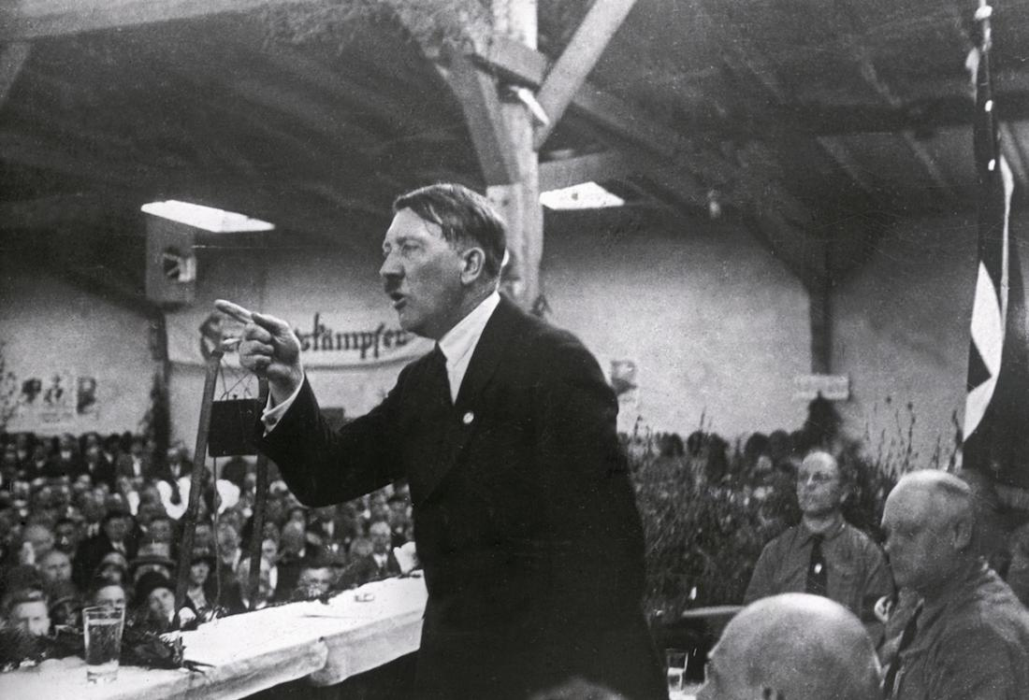
The Third Reich – Selling a Fuhrer to the World

Slide 22
The Third Reich – Preparing for the End of the War
Martin Borman realized that Germany’s greatest resource was its brainpower.
He evaluated the academic records of all Germans who had attended the universities since about 1920.
He identified those people who had the best academic and scientific potential, got them off the front and into positions where they could do research to enhance the future of the Reich.
He also got every second and third-tier general working with him on this project. Borman worked well with his fellow bureaucrats.
Mr. Borman began to formulate a plan to integrate the intellectual power of Nazi Germany into the rest of the West.

Slide 23
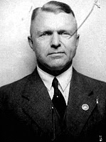
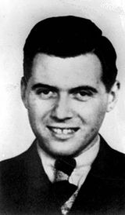
The Third Reich – Preparing for the End of the War
Once Martin Borman located these people, he placed them in positions where they could best serve the Reich.
A good example of this was Dr. Joseph Mengele.
He was a MASH doctor on the Russian front.
After winning an Iron Cross-first class for pulling two men out of a burning tank, he was sent to Poland to recover from his wounds. He happened to meet up with Dr. Karl Gentzken, the head doctor of the Waffen SS.
When Dr. Gentzken saw Dr. Mengele’s potential as a researcher, he made an appointment with Borman who also saw the potential. Dr. Mengele was transferred to the Auschwitz Concentration Camp where he could set up a lab to do his “research” on viruses. He had thousands of unwary subjects available for his untoward research.

Slide 24
Dr. Joseph Mengele’s Resume
It should be pointed out he was a bright young man.
He had two doctoral degrees:
Ph.D., University of Munich (1935)
M.D., University of Frankfurt (1938, Cum Laude)
Dr. Mengele was the author of several scientific papers which were highly regarded in the medical community.
It should be noted that both of Dr. Mengele’s degrees were revoked by their respective universities in the 1960s.
He ran Nazi operations around the world after Martin Borman died in 1959. He proved to be as good a manager as Borman was.

Slide 25
Can a Bible Code Show us What Dr. Mengele was Up To?
I had to wonder what Dr. Mengele was really doing research on at Auschwitz? After learning about the “Allied Legend” from scholars like Dr. Joseph P. Ferrell, I have come to question what has been taught in our history books.
It seems like after the War, we have been subjected to one “virus” after another. Could this be what Dr. Mengele was REALLY working on?
The first question I had to ask was whether Dr. Mengele knew of the existence of viruses?
I did a little research and discovered that medicine has known about Contagium vivum fluidum (viruses) since the late 19th century.
Let’s run some trial Bible Codes and see if this is possible?

Slide 26
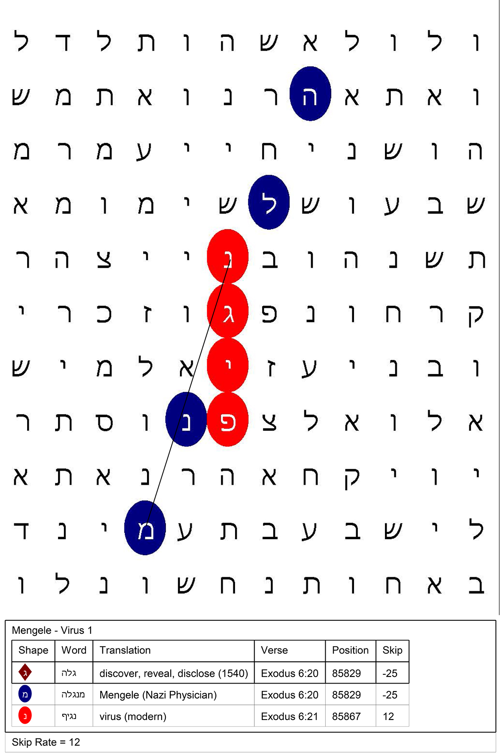
Developing a Bible Code
We found a hit on the two words: “Mengele” and “Virus” at a rather small skip rate of every twelve letters hidden in Exodus 6:20-21.
Here is the background scripture reference:
And Amram took him Jochebed his father's sister to wife; and she bare him Aaron and Moses: and the years of the life of Amram were a hundred and thirty and seven years.
And the sons of Izhar: Korah, and Nepheg, and Zichri. (Exodus 6:20-21)

Slide 27
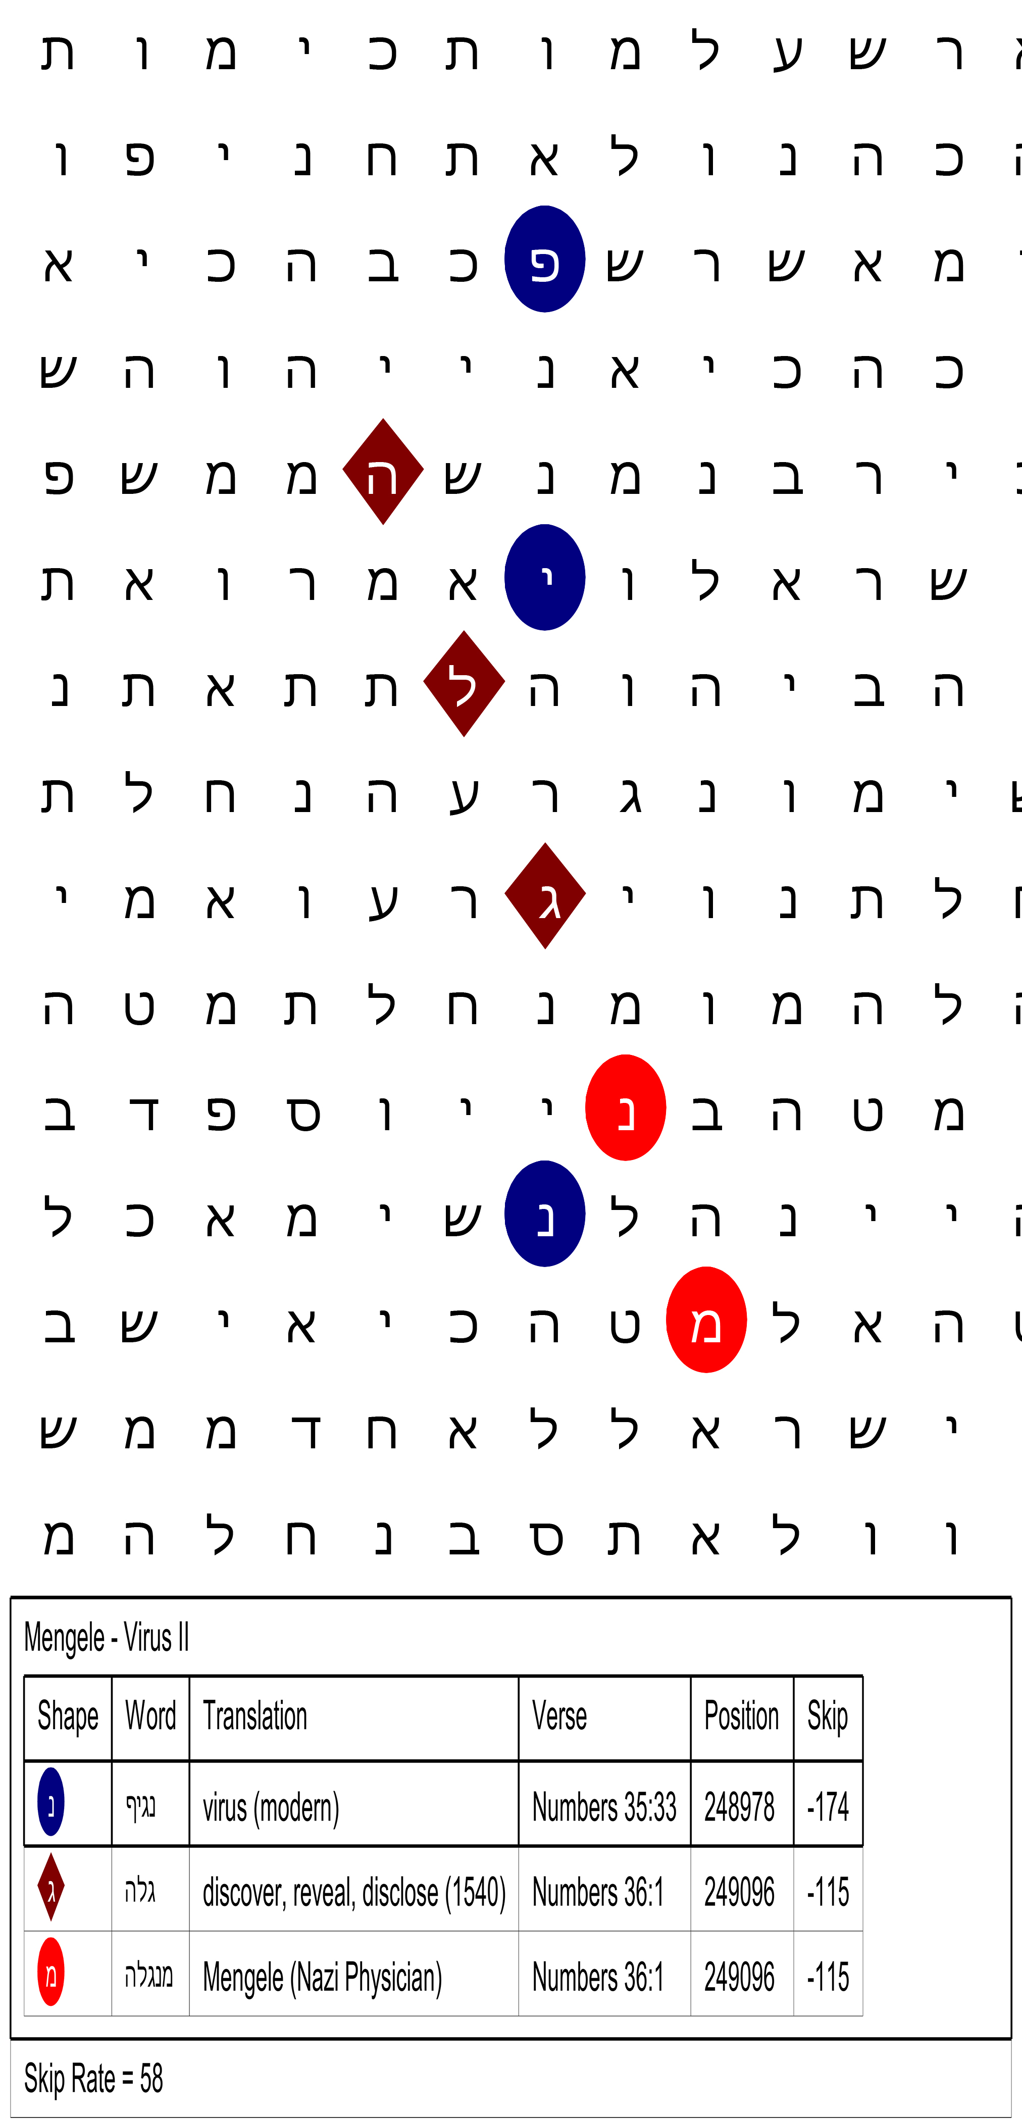
Developing a Bible Code
We found another hit at Numbers 35:33-36:1 at a skip rate of 58.
Here is the scripture reference:
And to devise curious works, to work in gold, and in silver, and in brass, And in the cutting of stones, to set them, and in carving of wood, to make any manner of cunning work. (Exodus 35:32-33)
We will look at this Bible Code further…

Slide 28
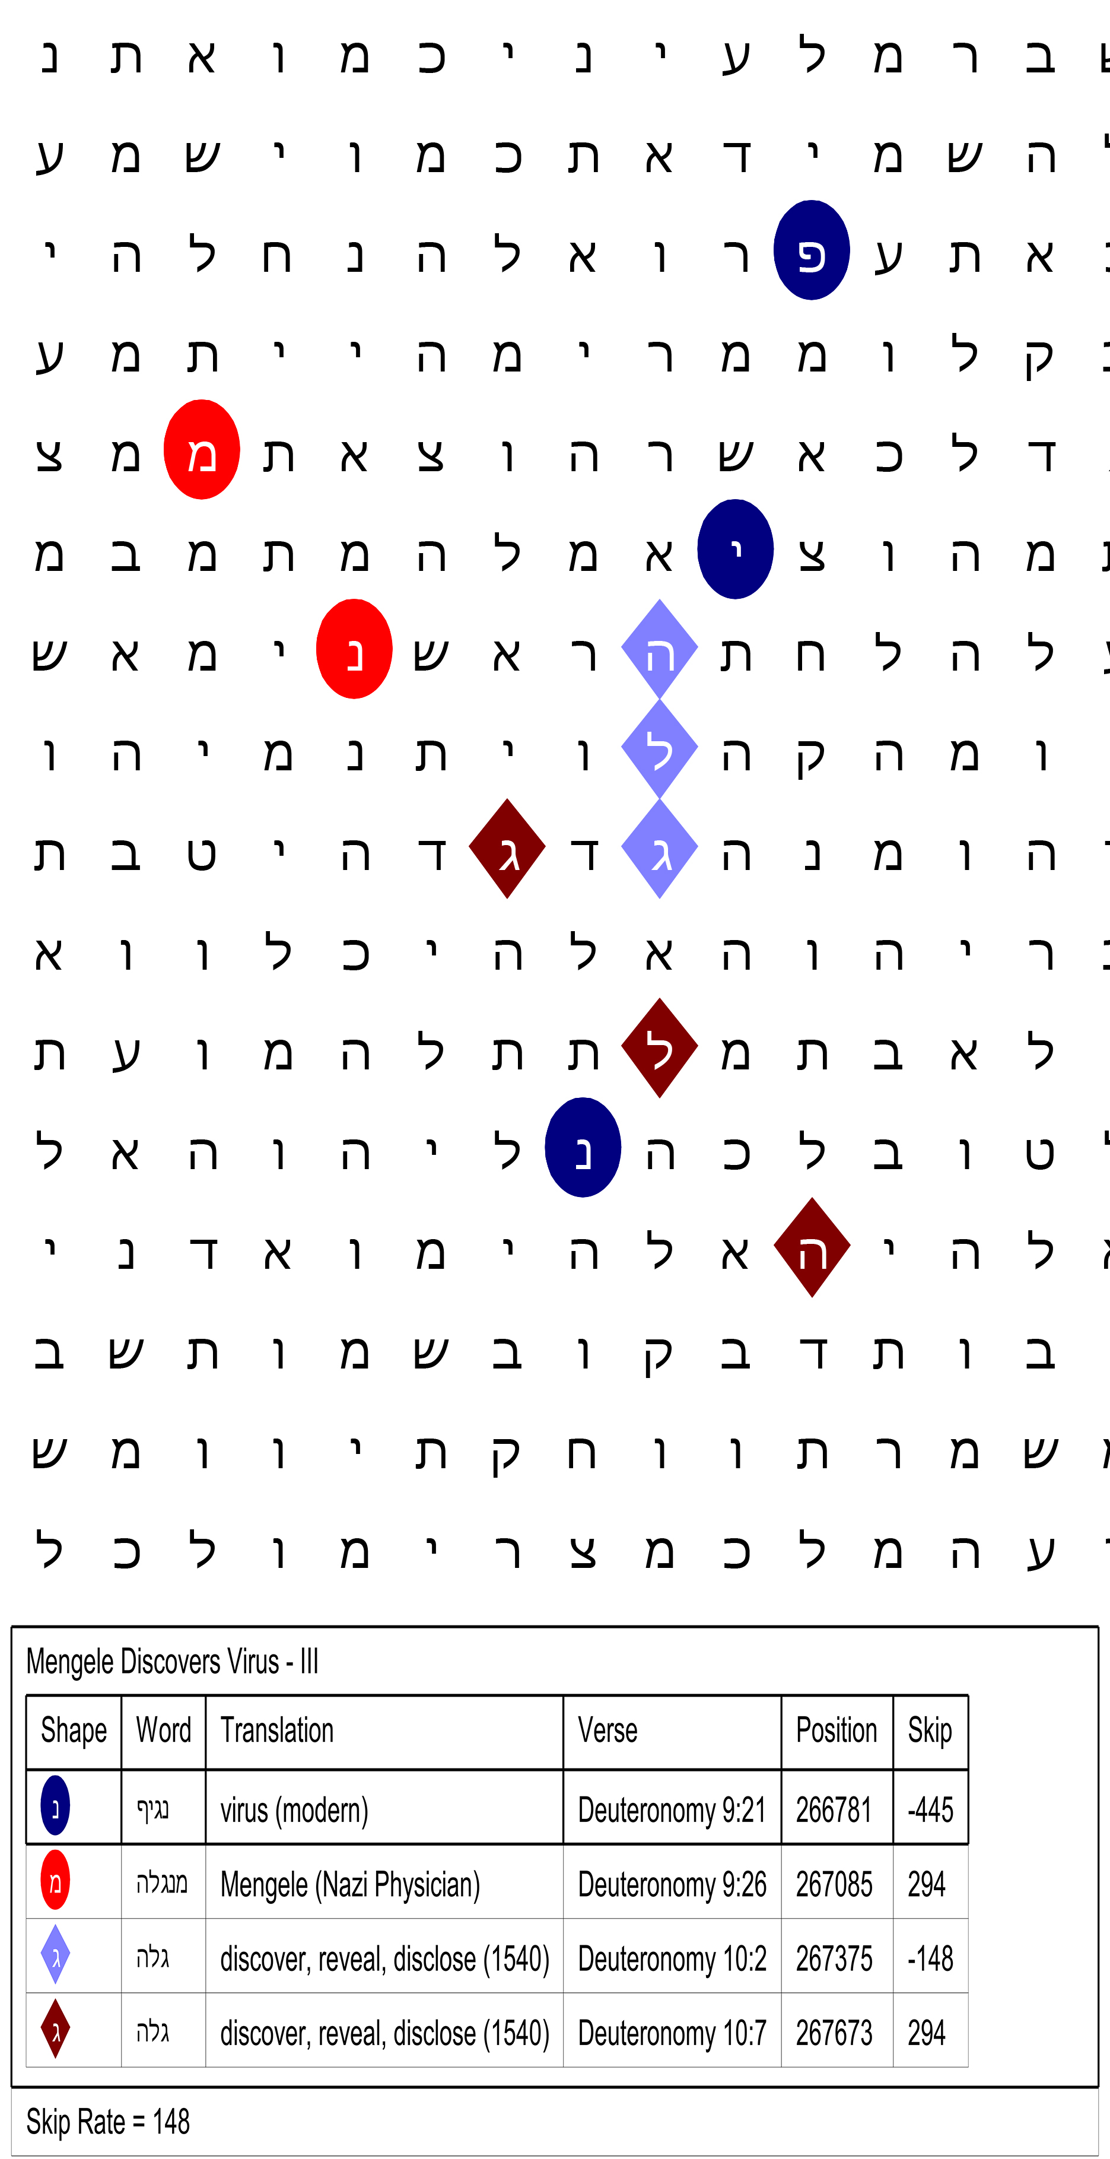
Developing a Bible Code
I found this hit at a skip rate of 148. The word for “discover, reveal, disclose” was also there.
The key verse for this code is Deuteronomy 9:21:
And I took your sin, the calf which ye had made, and burnt it with fire, and stamped it, and ground it very small, even until it was as small as dust: and I cast the dust thereof into the brook that descended out of the mount. (Deuteronomy 9:21)

Slide 29
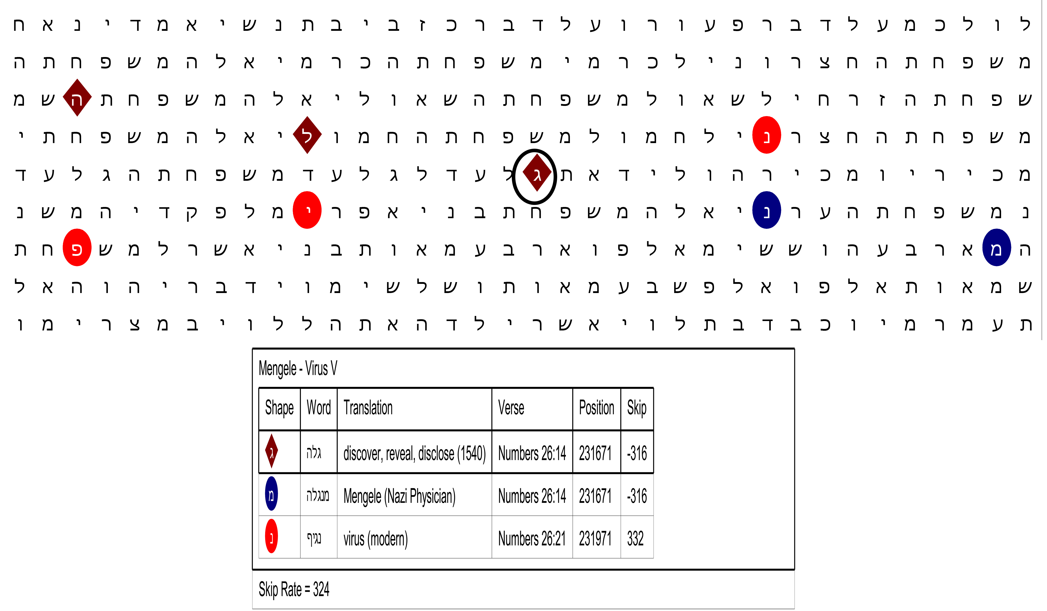
Developing a Bible Code
This code has the highest skip rate we have seen at 324. This time, we see a crisscross pattern, which is a common occurrence in Bible Codes, but harder to add words to.

Slide 30
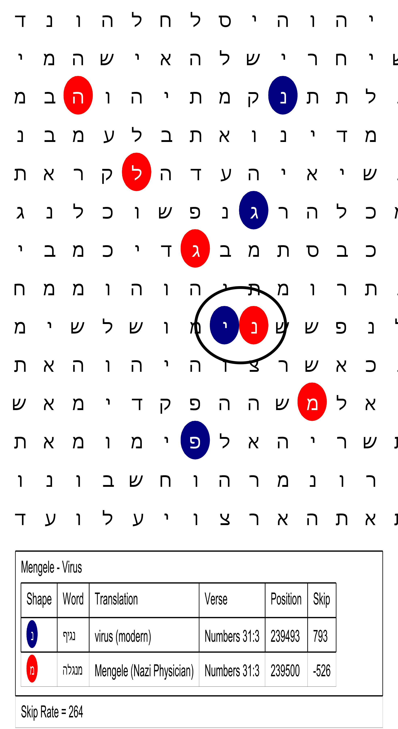
Developing a Bible Code
This code is at a skip rate of 264, but the words only touch in this case. The scripture in question is Numbers 31:3 where Moses musters troops for the upcoming war with the Midianites.
This Bible Code has two letter that “touch” each other. Not as mathematically significant and two words with a Hebrew letter in common, but still significant enough for someone to consider doing more research.

Slide 31
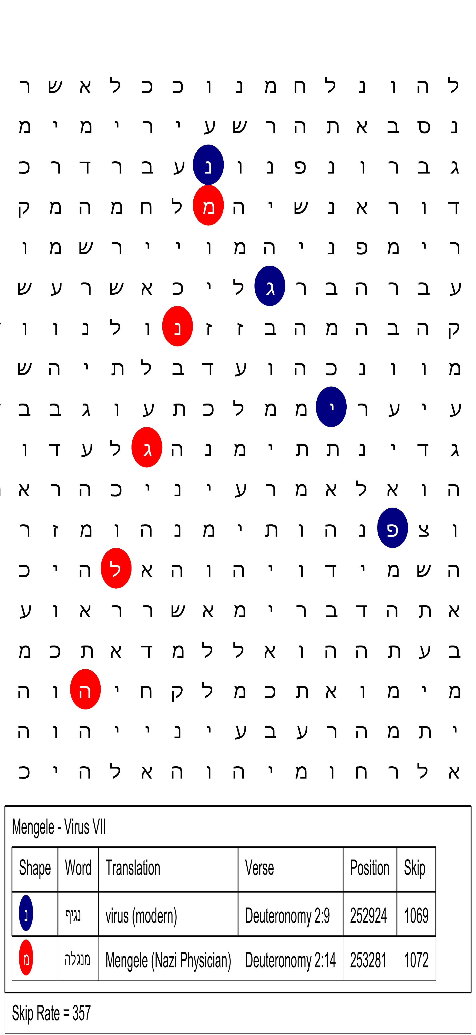
Developing a Bible Code
This Bible Code is cone-shaped and works out at a skip rate of 357, while the words come out at 1,069 and 1,072 skips respectively.
Interesting verse:
And the space in which we came from Kadeshbarnea, until we were come over the brook Zered, was thirty and eight years; until all the generation of the men of war were wasted out from among the host, as YHWH sware unto them. (Deuteronomy 2:14)

Slide 32
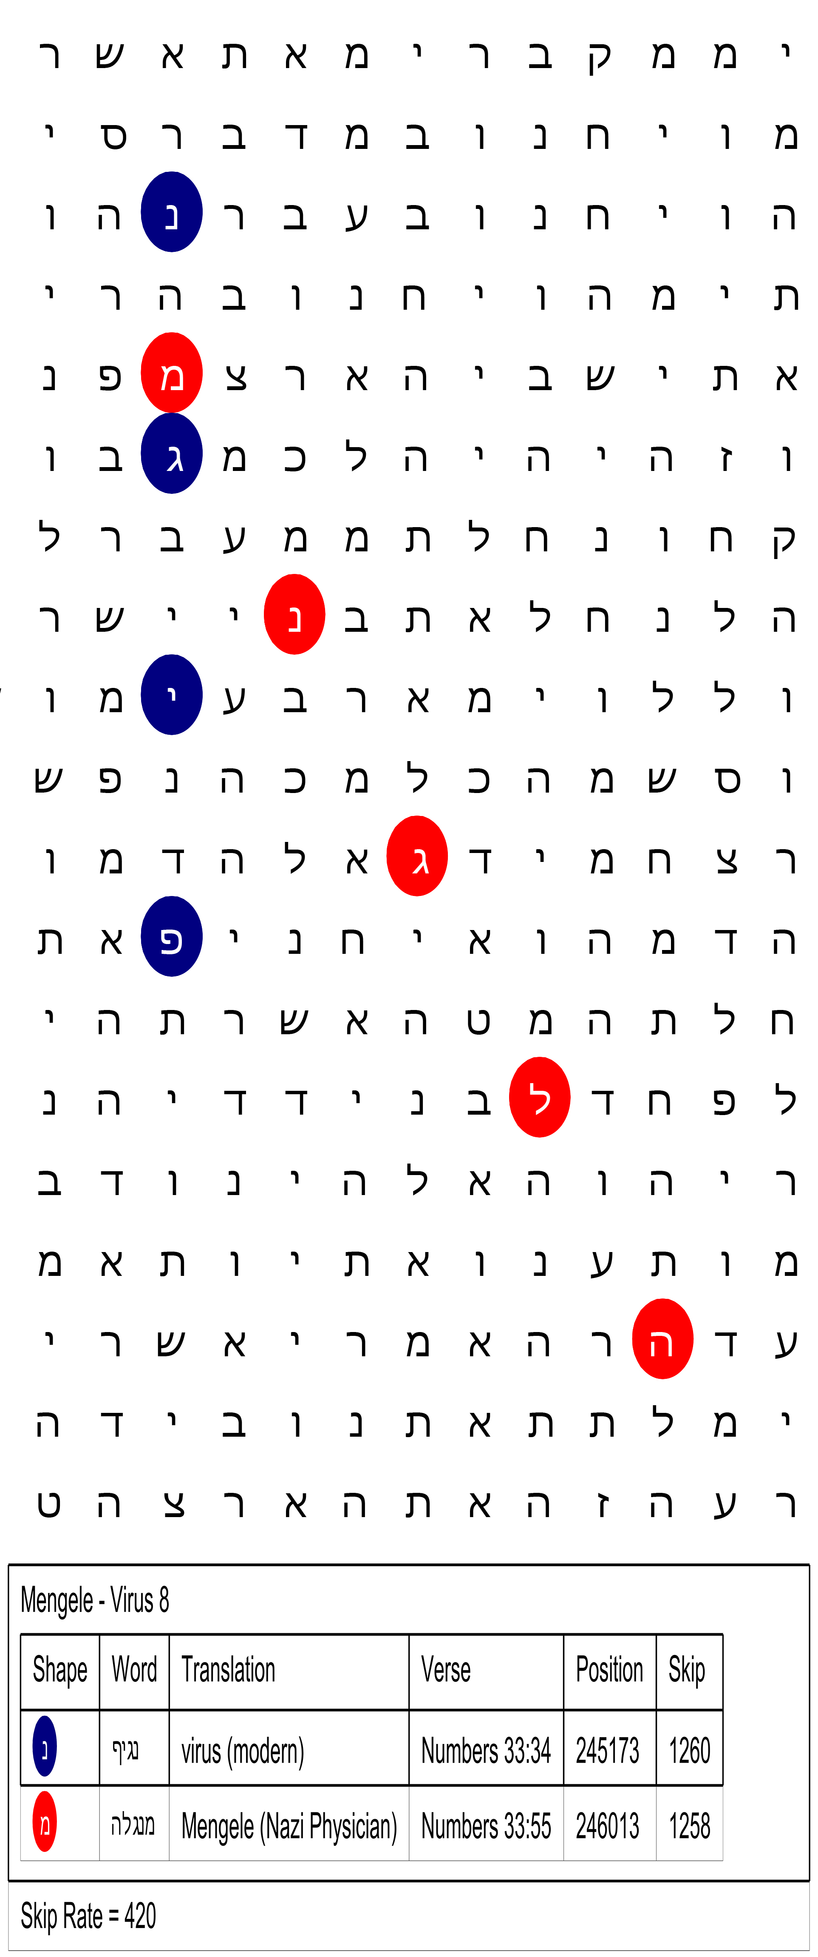
Developing a Bible Code
Here is yet another hit at a skip rate of 420. These come from the 34th chapter of Numbers even though the program has them in the 33rd chapter which is consistent with Jewish versions of the Tenach.
Here we see the name Mengele coming as a tail off of the word Virus.
Again, this code is not mathematically as significant as the earlier ones, but it is still worthy of our further consideration.

Slide 33
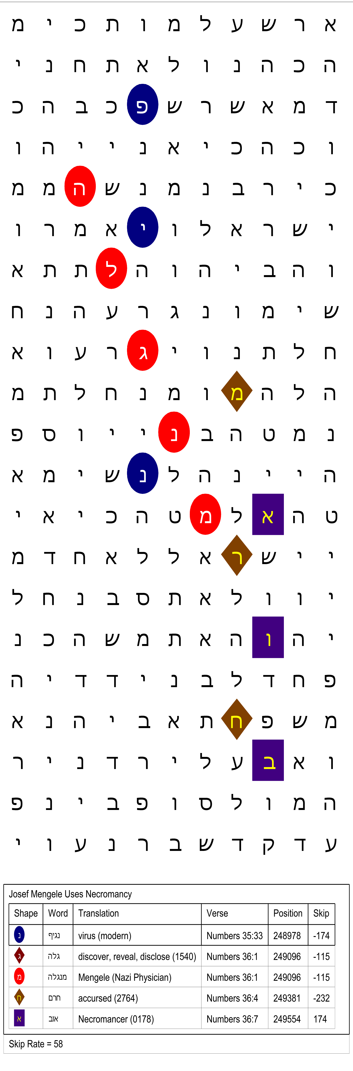
Developing a Bible Code
In this Bible Code, we have added a couple of words to connect the word “Mengele.”
The first word I got was “Necromancer,” but it did not touch “Mengele” directly but was one space off.
Since people who delve in the occult get a curse by practicing it, I placed “accursed” in the code and found it connected Mengele and Necromancer.
I would interpret this as Josef Mengele visiting a Necromancer rather than being one.
Even though we have five words in this Bible Code, I am a long ways from having a valid Bible Code. Normally, I do not find a Bible Code valid unless I have at least 15 words and don’t publish them unless I have 25 words. (https://biblecodes.co)

Slide 34
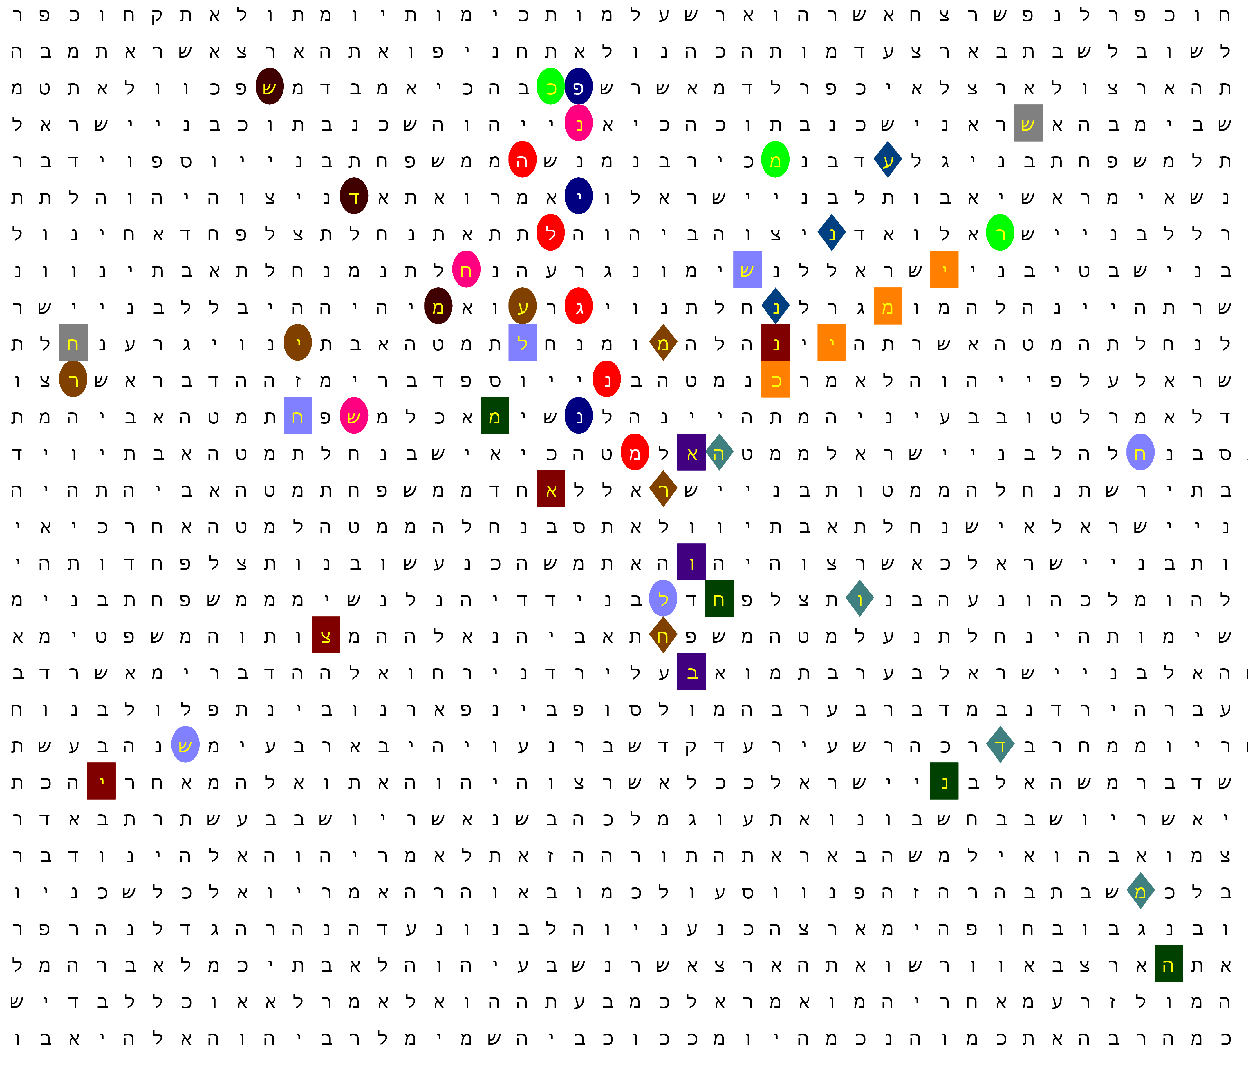
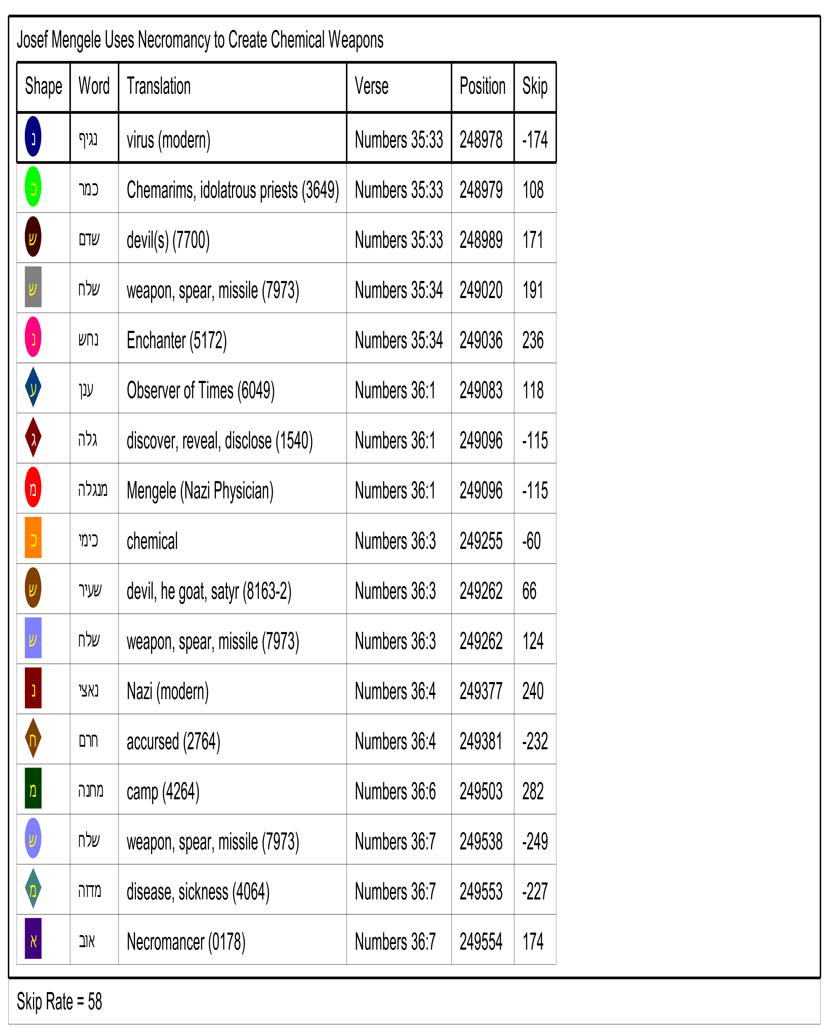

Slide 35
Analysis of Josef Mengele Bible Code
Some things we can get from this Bible Code:
Dr. Mengele’s main function for Nazi Germany was the creation of Chemical Weapons, just as Dr. Bishop explained to us.
Dr. Mengele did not hesitate to consult occultists and Necromancers to the get information he needed to advance his research.
He also used Chemarims (Kemariym) to perform occult ceremonies to obtain information needed for his research.
It should be pointed out he was a bright young man. He had two doctoral degrees (later revoked):
Ph.D., University of Munich (1935)
M.D., University of Frankfurt (1938, Cum Laude)
Dr. Mengele was the author of several scientific papers which were highly regarded in the medical community.

Slide 36
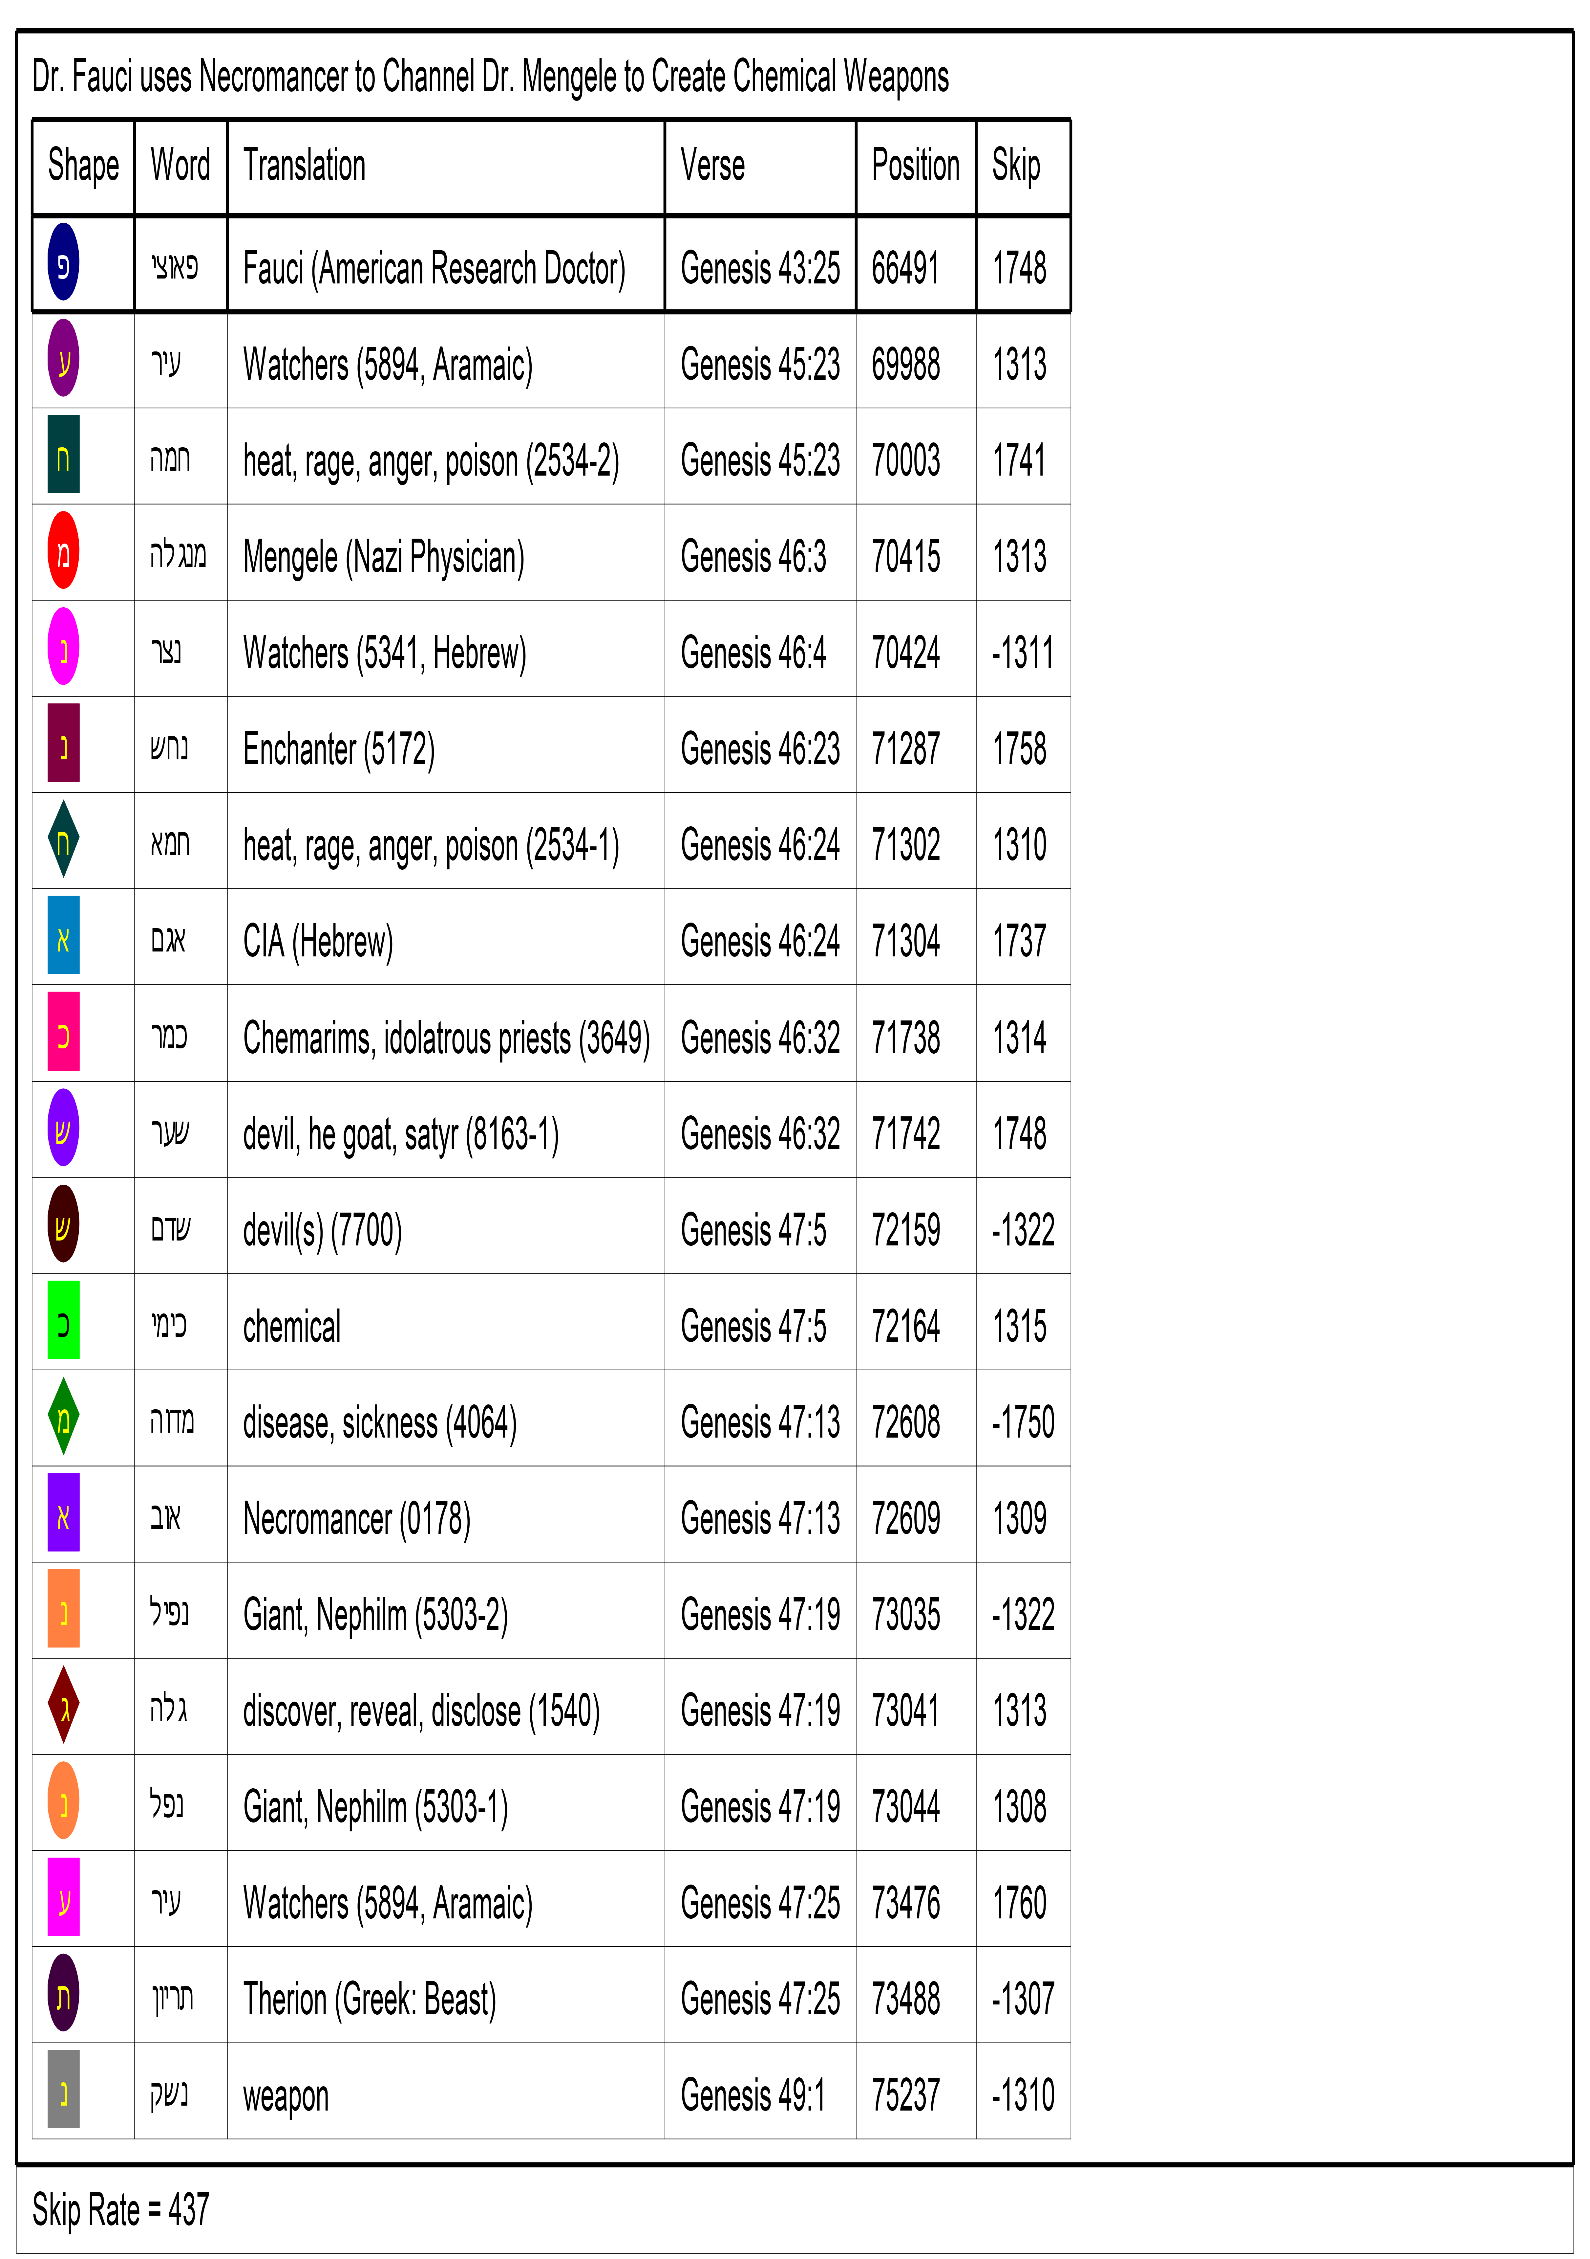
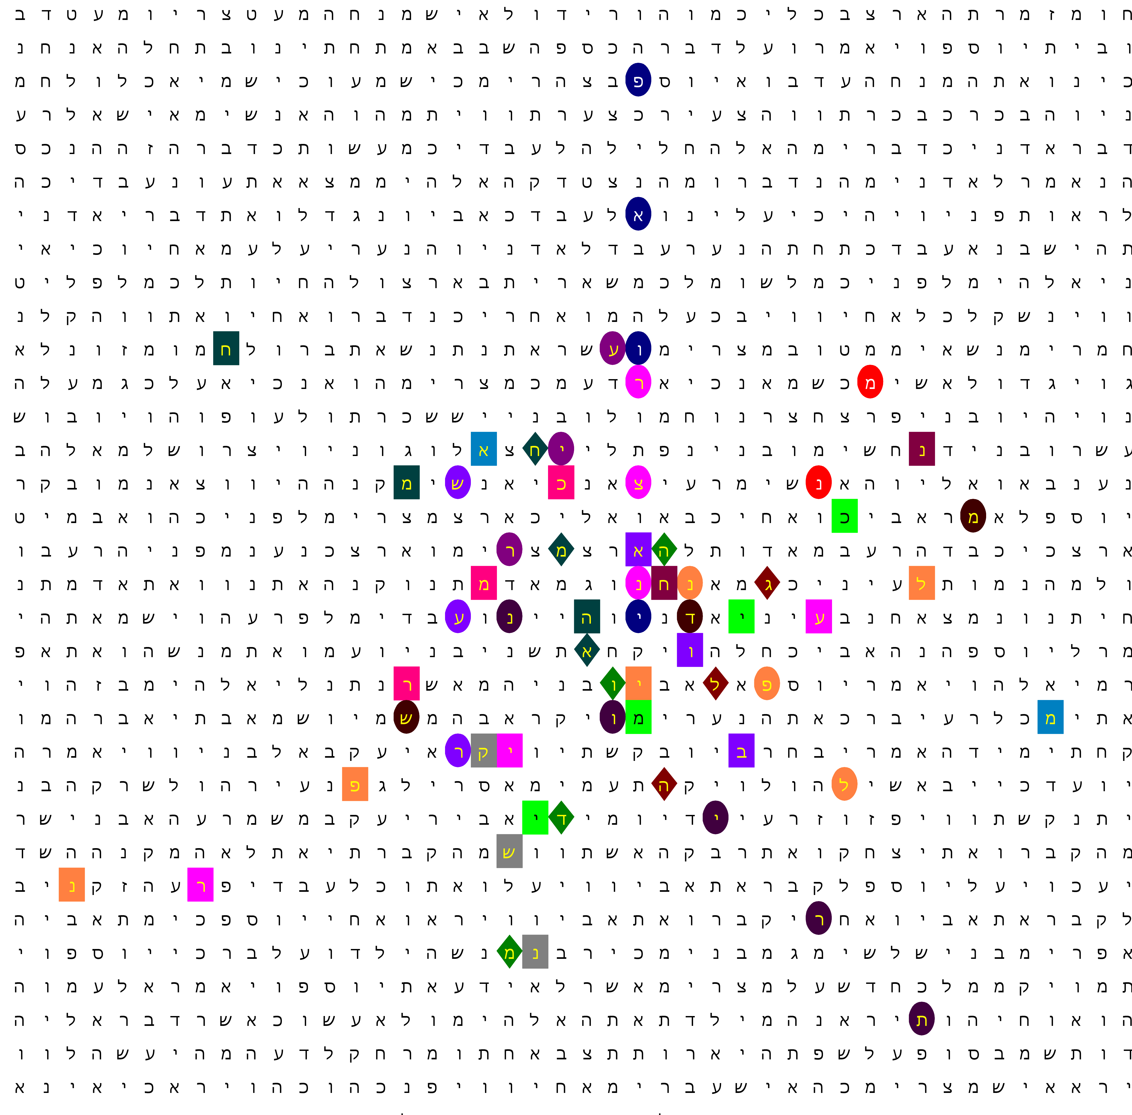

Slide 37
Analysis of Fauci - Mengele Bible Code
Some things we can get from this Bible Code:
It turns out that Dr. Fauci has been channeling Dr. Josef Mengele to create Chemical Weapons to poison us so we can get and be sick.
Overseeing this effort is the “Watchers,” a “beast” demon named Therion identified in the writings of Alistair Crowley and likely others not identified in this Code yet. It should be noted that using Hebrew Gematria that the Hebrew word for Therion total 666.
It appears they are trying to turn Yah’s creation into Nephilm (Giants). It should already be noted that players in most professional sports are taller, heavier, and faster than they were just a couple of decades ago. These increases seem to coincide with the application of vaccines in children starting in the 1960s.
It is looking like they are getting their primary funding from the CIA.

Slide 38
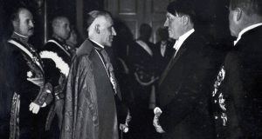
The Third Reich – Preparing for the End of the War
At the end of the War, Martin Borman began to move large amounts of money into numbered Swiss bank accounts. That way, the Allies could not track the money back to Nazi sources
He also had talks with Vatican officials about how to move German soldiers to locations in South America. Germany had very good relations with Pope Pius XII.

Slide 39
The Seven “Kings” of the Third Reich
Pius XI – (1922 – 1939) – Fallen
Pius XII – (1939 – 1958) – Fallen
John XXIII – (1958 – 1963) – Fallen
Paul VI – (1963 – 1978) – Fallen
John Paul II – (1978 – 2005) – Fallen
Benedict XVI – (2005 - 2022) – Died on December 31, 2022
Francis I – Usurped the Papacy on March 13, 2013
Some Conservative Catholic writers are starting to consider Francis I an “antipope.”
As such, they consider the Papacy vacant…

Slide 40
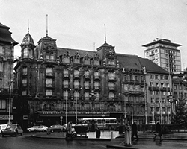
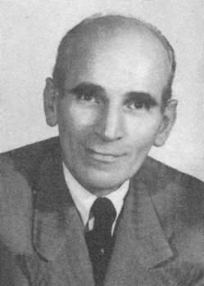
The Third Reich – Post War
Martin Borman convened a meeting in Strasbourg, France to outline his plans for an economic Nazi Reich.
With Allied forces about 100 miles to the west, a high-security meeting was held at the Hotel Maison Rouge was held in secret in early August of 1944.
All the German industrialists were at this meeting along with every high-ranking member of the SS except for its leader: Heinrich Himmler.
The meeting was chaired by honorary Lt. General Dr. Otto Scheid, a highly regarded architect. He outlined Borman’s plans to all the meeting’s participants.

Slide 41
The Third Reich – Post War
It is likely that not even Adolf Hitler was aware of this meeting!
However, it is likely that an American agent was aware of and maybe attended this meeting. His name was Allen Dulles.
Bible Codes indicate that Dulles was in the process of being inducted to the highly secret Order of the Black Sun.
Dulles promoted the idea to his superiors that the United States needed to initiate a new program to get German scientists to the USA.
They called the program “Operation Paperclip.” Dulles’ superiors agreed with him, but never told Presidents Truman and Eisenhower the full details of the program.

Slide 42
The Third Reich – Post War
Despite Mr. Hitler’s objections to the inclusion of the Royal Families in their planning, Martin Borman did include them and the Vatican in his afterwar program.
Their castles and monasteries were handy places to stash people wanted by the Allied governments.
Many of the SS members with “war crimes” issues were shuttled into Italy via the Vatican’s “Rat lines” from Germany, to Italy, and then shuttled by ship to Argentina, Chile, Paraguay, and Brazil.
Scientists and other second-level Germany academics were shuttled to the United States via Operation Paperclip. They would be inserted into government, education, and industry.

Slide 43


Thank You
Prof. Tom Mack
Email: tom.mack@whitestonefoundation.org
Bible Code Website: https://biblecodes.co
Main Website: https://whitestonefoundation.org

